Slide 1
Modern Systems Analysis
and Design
Sixth Edition
Hoffer · George · Valacich

Slide 2
1
CHAPTER ONE
The Systems Development
Environment

Slide 3
Learning Objectives
1
Define information systems analysis and design.
2
Describe the Information Systems Development Life Cycle (SDLC).
3
Explain Rapid Application Development (RAD), prototyping, Computer-Aided Software Engineering (CASE), and Service-Oriented Architecture (SOA).
4
Describe Agile methodologies and eXtreme Programming (XP) in depth.
5
Explain Object-Oriented Analysis and Design (OOAD) and the Rational Unified Process (RUP).
3

Slide 4
FOUNDATIONS
Introduction
✓
Complex organizational process
Systems analysis and design blends business goals, human workflow, and technology into one coordinated effort.
✓
Builds and maintains information systems
It is used to develop new computer-based information systems and to keep existing ones running and relevant.
✓
A team effort
Business stakeholders and systems professionals collaborate throughout, each bringing a different lens to the problem.
4

Slide 5
FOUNDATIONS
Introduction (cont.)
An organizational approach to systems analysis and design is shaped by three ingredients working together:
1
2
3
Techniques
Methodologies
Tools
FIGURE 1-1 These three elements together drive a disciplined, repeatable approach to building information systems.
5

Slide 6
FOUNDATIONS
Techniques, Methodologies, and Tools
Technique
A specific, repeatable process an analyst follows to keep work well thought-out and clear to the rest of the project team.
Methodology
A comprehensive, multi-step approach to system development that guides the team's work and shapes the quality of the final product.
Tool
Typically a software program that makes a technique easier to apply, while keeping the work aligned with the overall methodology.
6

Slide 7
A BRIEF HISTORY
A Modern Approach to Systems Analysis and Design
1950s
1960s
1970s
Focus on efficient automation of existing manual processes.
Third-generation languages (3GL) arrive alongside faster, more reliable computers.
System development starts to look like a true engineering discipline.
7

Slide 8
A BRIEF HISTORY
A Modern Approach to Systems Analysis and Design (cont.)
1980s
1990s
2000s
Fourth-generation languages (4GL), CASE tools, and object-oriented methods break through.
Emphasis shifts to system integration, GUI applications, client/server platforms, and the Internet.
Web application development, wireless PDAs, and component-based applications take hold.
A 3GL is a high-level, largely machine-independent language; a 4GL tells the computer what to do rather than how to do it.
8

Slide 9
A BRIEF HISTORY · UPDATED
A Modern Approach to Systems Analysis and Design (cont.)
2010s
2020s
Today
Cloud platforms, mobile-first design, and DevOps bring continuous delivery to the mainstream.
Low-code/no-code platforms and API-first architectures speed up delivery further.
AI-assisted coding and design tools help analysts and developers draft, test, and refine systems faster.
the SDLC's phases endure, even as the tools around them keep changing.
9

Slide 10
FOUNDATIONS
A Modern Approach to Systems Analysis and Design (cont.)
Application Software
Systems Analyst
Computer software designed to support organizational functions or processes — the end product analysts help deliver.
The organizational role most responsible for analyzing and designing information systems, bridging business needs and technical solutions.
10

Slide 11
METHODOLOGY
Developing Information Systems
System Development Methodology
A standard process an organization follows to complete every step needed to analyze, design, implement, and maintain information systems.
In computing's early years, analysis and design was treated as an art. As the demand for software grew, industry and academia developed disciplined work methods — turning analysis and design into a repeatable process that shapes the quality of the resulting system.
11

Slide 12
METHODOLOGY
Systems Development Life Cycle (SDLC)
The traditional methodology used to develop, maintain, and eventually replace information systems.
1
2
3
4
5
Planning
→
Analysis
→
Design
→
Implementation
→
Maintenance
12

Slide 13

METHODOLOGY
Standard and Evolutionary Views of SDLC
Planning
Planning
Analysis
Maintenance
Analysis
Maintenance
The systems
development life cycle
Implementation
Design
Implementation
Design
Standard view: sequential phases
Evolutionary view: iterative refinement
13

Slide 14
SDLC IN DEPTH
Systems Development Life Cycle (cont.)
1
Planning
An organization's total information system needs are identified, analyzed, prioritized, and arranged so the most valuable projects move forward first.
2
Analysis
System requirements are studied and structured, often using tools such as use-case diagrams and sequence diagrams to capture how the system should behave.
14

Slide 15
SDLC IN DEPTH
Systems Development Life Cycle (cont.)
3
Design
A description of the recommended solution is converted first into logical, and then physical, system specifications.
■
Logical Design
All functional features chosen during analysis are described independently of any specific computer platform — the "what," not the "how."
15

Slide 16
SDLC IN DEPTH
Systems Development Life Cycle (cont.)
●
Physical Design
The logical specifications from logical design are translated into technology-specific details, from which all programming and system construction can proceed.
16

Slide 17
SDLC IN DEPTH
Systems Development Life Cycle (cont.)
4
Implementation
The information system is coded, tested, installed, and supported within the organization.
5
Maintenance
The information system is systematically repaired and improved to keep pace with organizational needs.
17

Slide 18
SDLC IN DEPTH
The Heart of the Systems Development Process
Analyze
Design
Code
Test
→
→
→
FIGURE 1-7 / 1-8 The analysis–design–code–test loop
Current practice combines analysis, design, and implementation into a single iterative and parallel process rather than four rigid, separate steps.
18

Slide 19
CLASSIC MODEL
Traditional Waterfall SDLC
Planning
Deadline 1
Analysis
Design
Implementation
Maintenance
One phase begins only when the previous one completes, with little backtracking or looping.
FIGURE 1-9 A traditional waterfall SDLC
19

Slide 20
CLASSIC MODEL
Problems with the Waterfall Approach
✕
System requirements are “locked in” once determined, making later changes costly or difficult.
✕
User involvement is limited mainly to the requirements phase, so feedback comes too late to matter.
✕
Heavy focus on hitting milestone deadlines can come at the expense of sound development practices.
20

Slide 21
WHAT'S NEXT
Different Approaches to Improving Development
1
CASE Tools
2
Rapid Application Development
Automate diagramming, prototyping, and code generation.
Compress design and build time through close collaboration.
3
Agile Methodologies
4
eXtreme Programming
Adapt continuously to changing, unpredictable requirements.
Push discipline and feedback to the level of daily coding practice.
21

Slide 22
IMPROVING DEVELOPMENT · CASE
Computer-Aided Software Engineering (CASE) Tools
Diagramming tools
Enable graphical representation of system models, from data flows to entity relationships.
Display and report generators
Help prototype how a system will “look and feel” before it is built.
22

Slide 23
IMPROVING DEVELOPMENT · CASE
Computer-Aided Software Engineering (CASE) Tools (cont.)
Analysis tools
Automatically check diagrams, forms, and reports for consistency and completeness.
Central repository
A shared storehouse that integrates diagrams, reports, and project management specifications.
23

Slide 24
IMPROVING DEVELOPMENT · CASE
Computer-Aided Software Engineering (CASE) Tools (cont.)
Documentation generators
Standardize technical and user documentation across the project.
Code generators
Automatically produce program and database code directly from design documents, diagrams, forms, and reports.
24

Slide 25
IMPROVING DEVELOPMENT · CASE
CASE Tools in Practice: A Class Diagram
Order
Customer
Product
+ orderId
+ date
+ total
+ calculateTotal()
+ name
+ accountNo
+ placeOrder()
+ sku
+ price
+ checkStock()
FIGURE 1-10 A class diagram, of the kind produced by tools such as IBM Rational Rose
Class diagrams capture the objects a system works with, their attributes, and the relationships between them — a foundation for object-oriented design (covered later in this chapter).
25

Slide 26
IMPROVING DEVELOPMENT · RAD
Rapid Application Development (RAD)
An approach to developing information systems that promises faster, cheaper results by having developers and end users work together, in real time, throughout the build.
A methodology built to radically decrease design and implementation time.
Build something quickly → show it to users → get feedback → improve it → repeat.
It relies on:
Extensive user involvement
Prototyping
Joint Application Design (JAD) sessions
Integrated CASE tools
Code generators
26

Slide 27
IMPROVING DEVELOPMENT · RAD
RAD Life Cycle
Requirements
Planning
User
Design
Construction
Cutover
→
→
→
FIGURE 1-11 RAD life cycle — user design and construction often loop repeatedly before cutover.
27

Slide 28
IMPROVING DEVELOPMENT · RAD
RAD Life Cycle (Example)
Developers and users work together to design the system.
The user can immediately say: "I don't like this screen. Students should be able to search courses here.“
The design is then changed.
This is one of the most important ideas in RAD: Users participate continuously in the design.
1
2
The developers and users identify the main business requirements.
For example, for a student registration system:
Students can view courses
Students can register for courses
Students can drop courses
Advisors can approve registration
The goal is not necessarily to specify every detail at this stage
3
The developers build the actual system rapidly.
RAD often makes heavy use of:
Reusable components
Frameworks
Code generators
Database tools
Prototyping tools
Low-code/no-code tools
Instead of building everything from scratch, developers try to reuse existing components.
The finished system is prepared for actual use.
This can include:
Final testing
Data conversion
User training
Deployment
Maintenance
Then the system becomes available to users.
4
→
→
27

Slide 29
IMPROVING DEVELOPMENT · SOA
Service-Oriented Architecture (SOA)
An approach to systems development based on building complete systems by assembling software components — each modeling a generic business function.
28

Slide 30
IMPROVING DEVELOPMENT · SOA
Service-Oriented Architecture (SOA)
A service is a software component that performs a specific business function and makes that function available to other applications.
Services communicate through messages.
For example, a SOAP-based service might exchange XML messages.
Modern service-oriented systems may also use:
REST APIs
  JSON
HTTP
messaging systems
28

Slide 31
IMPROVING DEVELOPMENT · SOA
Service-Oriented Architecture (cont.)
Online Store App
Loan Application
Credit Check
Service
Mobile Banking App
Partner Service
FIGURE 1-12 A single credit-check service reused by several applications and other services
29

Slide 32
IMPROVING DEVELOPMENT · AGILE
Agile Methodologies
Motivated by the recognition that software development is fluid, unpredictable, and dynamic — not a fixed, fully specifiable process.
Adaptive, not predictive
Plans flex as understanding of the problem grows.
People over roles
Individuals and their interactions matter more than rigid job titles.
Self-adapting processes
The team continually tunes how it works, not just what it builds.
30

Slide 33
AGILE · FOUNDATIONS
The Agile Manifesto: Four Core Values
Written in 2001 by a group of software practitioners, the Agile Manifesto reframed what teams should value most — without discarding the item on the right entirely.
Individuals and interactions
over
processes and tools
Working software
over
comprehensive documentation
Customer collaboration
over
contract negotiation
Responding to change
over
following a plan
31

Slide 34
AGILE · FOUNDATIONS
Agile Principles in Practice
✓
Deliver working software early and continuously.
✓
Welcome changing requirements, even late in development.
✓
Ship frequently — weeks rather than months between releases.
✓
Business people and developers work together daily.
✓
Build projects around motivated, trusted individuals.
✓
Maintain a sustainable pace indefinitely.
✓
Keep designs simple; maximize the work not done.
✓
Let teams self-organize and reflect regularly on how to improve.
32

Slide 35
AGILE · FRAMEWORKS
Popular Agile Frameworks
Scrum
The most popular Agile framework. Work is organized into fixed-length sprints (typically 1-4 weeks), with defined roles (Product Owner, Scrum Master, Development Team) and ceremonies (sprint planning, daily standup, sprint review, retrospective). Great for teams needing structure and clear cadence.
Short video explaining scrum: https://www.youtube.com/watch?v=9TycLR0TqFA&t=5s
Kanban
A flow-based approach using a visual board with columns (e.g., To Do → In Progress → Done) and work-in-progress (WIP) limits. No fixed iterations — work is pulled continuously as capacity allows. Ideal for teams with unpredictable or continuous streams of work (e.g., support/ops teams).
Lean Software Development
Adapts Lean manufacturing principles (from Toyota) to software: eliminate waste, amplify learning, decide as late as possible, deliver fast, build integrity in, and see the whole. More a set of principles than a prescriptive process.
eXtreme Programming (XP)
Focuses heavily on engineering practices to ensure high code quality and technical excellence: TDD, pair programming, continuous integration, refactoring, simple design, and collective code ownership. Often combined with Scrum ("Scrumban" isn't this, but XP practices frequently layer on top of Scrum).
33

Slide 36
AGILE · FRAMEWORKS
Popular Agile Frameworks
Aspect | Scrum | Kanban
Cadence | Fixed-length sprints (1-4 weeks) | Continuous flow, no fixed iterations
Roles | Defined roles: Product Owner, Scrum Master, Development Team | No prescribed roles — works with existing team structure
Planning | Sprint planning at the start of each sprint; scope is locked for the sprint | Continuous planning; work pulled as capacity allows
Change mid-cycle | Discouraged — sprint backlog is fixed once sprint starts | Welcomed — new items can be added anytime
Key mechanism | Sprint backlog + burndown chart | Visual board + WIP (work-in-progress) limits
Meetings/ceremonies | Daily standup, sprint planning, sprint review, retrospective | No mandatory meetings (though many teams add standups)
Metrics | Velocity (story points per sprint) | Cycle time, lead time, throughput
Delivery | At the end of each sprint | Continuously, as each item is completed
Best for | Teams that benefit from structure, predictable rhythm, and batching work (e.g., product development with defined feature sets) | Teams with variable, unpredictable, or continuous work (e.g., support, ops, maintenance)
Flexibility | Lower — commit to sprint scope | Higher — reprioritize anytime
Learning curve | Steeper — more roles/ceremonies to adopt | Gentler — can overlay on existing process
33

Slide 37
AGILE · APPLYING IT
When to Use Agile Methodologies
Agile approaches tend to work best when a project involves:
✓
Unpredictable or dynamic requirements
Needs are likely to shift as stakeholders learn more.
✓
Responsible, motivated developers
The team can be trusted to self-organize and self-correct.
✓
Engaged customers
Customers understand the process and stay actively involved.
34

Slide 38
AGILE · APPLYING IT
Agile in Practice: Benefits and Challenges
Benefits
Challenges
• Faster feedback from real users
• Harder to fix cost and scope up front
• Higher quality through constant testing
• Needs consistent customer availability
• Easier to adapt as priorities shift
• Requires discipline without heavy process
35

Slide 39
AGILE · EXTREME PROGRAMMING
eXtreme Programming (XP): Core Values
XP pushes agile discipline down to day-to-day coding practice. It rests on five core values:
1
2
3
4
5
Communication
Simplicity
Feedback
Courage
Respect
Talk constantly — across the team and with the customer.
Build the simplest thing that could possibly work.
Learn fast from tests, customers, and the running system.
Raise problems, refactor boldly, tell the truth about progress.
Value every contributor's work and judgment.
36

Slide 40
AGILE · EXTREME PROGRAMMING
XP Practices: Building It Right
1
Pair Programming
Two developers share one workstation — one writes code while the other reviews it in real time, catching defects immediately.
2
Test-Driven Development
Write an automated test before writing the code that makes it pass, so every feature ships with proof it works.
3
Continuous Integration
Merge and build code many times a day so integration problems surface within minutes, not weeks.
37

Slide 41
AGILE · EXTREME PROGRAMMING
XP Practices: Keeping It Right
4
Refactoring
Continuously restructure existing code to keep it clean, without changing what it does.
5
Collective Code Ownership & On-Site Customer
Any pair can improve any part of the code, and a real customer is available on the team to answer questions immediately.
6
Small Releases & Sustainable Pace
Ship small, working increments often, at a pace the team can sustain indefinitely — not through crunch.
38

Slide 42
AGILE · EXTREME PROGRAMMING
eXtreme Programming: Coding and Testing Together
Coding and testing operate together, in short, incremental cycles, rather than as separate phases performed by separate people.
Advantages
✓
Communication:
Constant pairing and shared code keep the whole team in sync.
✓
High productivity:
Fewer defects escape, so less time is lost to rework later.
✓
High-quality code:
Automated tests and refactoring keep the codebase healthy over time.
39

Slide 43
AGILE · EXTREME PROGRAMMING
XP: Where It Shines, and Where It Strains
Benefits
Challenges
• Defects caught early, close to the source
• Pair programming raises short-term staffing cost
• Codebase stays flexible and easy to change
• Needs a disciplined, experienced team
• Customer sees working software constantly
• Harder to coordinate across large, distributed teams
40

Slide 44
OBJECT ORIENTATION
Object-Oriented Analysis and Design (OOAD)
Based on objects rather than on data or processes in isolation.
Understand the problem as objects and their relationships, then design a software solution using those objects.
Object
A structure that encapsulates the attributes and behaviors of a real-world entity — bundling its data and the actions it can perform into one unit.
41

Slide 45
OBJECT ORIENTATION
Object-Oriented Analysis and Design (cont.)
Object Class
A logical grouping of objects that share the same attributes and behaviors.
Inheritance
A hierarchical arrangement of classes that lets subclasses inherit the properties and behaviors of their superclasses.
42

Slide 46
OBJECT ORIENTATION · RUP
Rational Unified Process (RUP)
An object-oriented systems development methodology built around four phases, each organized into a number of iterations.
Inception
Elaboration
Construction
Transition
Define scope, assess feasibility, understand user requirements, and prepare a development plan.
Detail user requirements and develop a baseline architecture.
Code, test, and document the software.
Deploy the system, and train and support users.
→
→
→
43

Slide 47
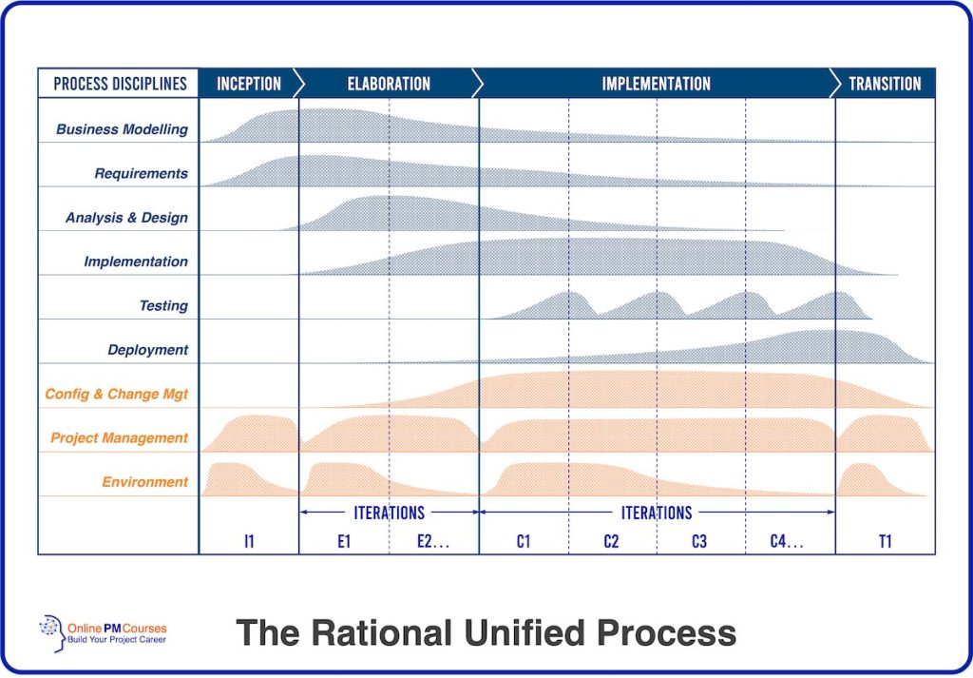
OBJECT ORIENTATION · RUP
Rational Unified Process (RUP)
43

Slide 48
WRAPPING UP
Our Approach to Systems Development
●
The SDLC serves as the organizing and guiding principle throughout this book.
●
Some boundaries between activities are drawn for learning purposes; in practice, the lines blur and phases overlap.
●
The goal is to help you understand every piece of the process, and how they all fit together.
45

Slide 49
GOOD TO KNOW
A Quick Distinction: IS vs. IT
Information Systems (IS)
Information Technology (IT)
The overall framework of people, processes, and technology working together to collect, process, and manage data for decision-making and business operations.
The hardware, software, and networking components specifically that enable data processing and communication.
Closely related, often used interchangeably — but distinct in scope.
46

